Slide 1
Real-Time Systems and Programming Languages
Alan Burns and Andy Wellings

Slide 2
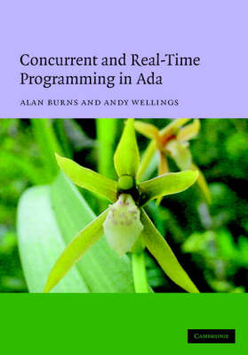
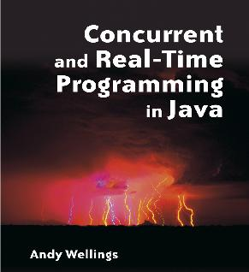
Other books
Ada 2005
RTSJ Version 1.0.1

Slide 3
Prerequisites
Basic understanding of Ada and C
Basic understanding of Computer Architectures.
Basic understanding of Operating Systems

Slide 4
Book Aims
Understanding of the broad concept of real-time systems
Practical understanding for industry
To stimulate research interest

Slide 5
Overall Technical Aims
To understand the basic requirements of real-time systems and how these requirements have influenced the design of real-time programming languages and real-time operating systems
To understand the implementation and analysis techniques which enable these requirements to be realized

Slide 6
What is a real-time system?
A real-time system is any information processing system which has to respond to externally generated input stimuli within a finite and specified period
  the correctness depends not only on the logical result but also the time it was delivered
  failure to respond is as bad as the wrong response!
The computer is a component in a larger engineering system => EMBEDDED COMPUTER SYSTEM
99% of all processors are for the embedded systems market

Slide 7
Terminology
Hard real-time — systems where it is absolutely imperative that responses occur within the required deadline, e.g. A flight control system
Soft real-time — systems where deadlines are important but which will still function correctly if deadlines are occasionally missed. E.g. Data acquisition system
Firm real-time — systems which are soft real-time but in which there is no benefit from late delivery of service
A single system may have hard, soft and firm real-time subsystems. In reality many systems will have a cost function associated with missing each deadline

Slide 8
Terminology
Time-aware — system makes explicit reference to time (eg. open vault door at 9.00
Reactive — system must produce output within deadline (as measured from input)
  Control systems are reactive systems
  Required to constraint input and output (time) variability, input jitter and output jitter control

Slide 9
Terminology
Time-triggered — computation is triggered by the passage of time
  Release activity at 9.00
  Release activity every 25ms – a periodic activity
Event-trigger — computation is triggered by an external or internal event
  The released activity is called sporadic if there is a bound on the arrival interval of the event
  The released activity is called aperiodic if there is no such bound

Slide 10
A simple fluid control system
Interface
Pipe
Input flow
reading
Flow meter
Processing
Valve
Output valve
angle
Time
Computer

Slide 11

A Grain-Roasting Plant
Bin
Furnace
Fuel Tank
grain
Pipe
fuel

Slide 12
A Widget-Packing Station
Computer
Switch
Switch
Assembly line
Bell
Line controller
Box
0 = stop
1 = run

Slide 13
A Process Control System
Process
Control
Computer
Valve
Temperature
Transducer
Stirrer
Finished
Products
Chemicals
and
Materials
PLANT

Slide 14
A Production Control System
Production
Control
System
Finished
Products
Parts
Machine Tools
Manipulators
Conveyor Belt

Slide 15
Command and Control System
Command
Post
Command and Control
Computer
Temperature, Pressure, Power and so on
Terminals
Sensors/Actuators

Slide 16
A Typical Embedded System
Real-Time
Clock
Algorithms for
Digital Control
Interface
Engineering
System
Data Logging
Remote
Monitoring System
Database
Data Retrieval
and Display
Display
Devices
Operator’s
Console
Real-Time Computer
Operator
Interface

Slide 17
Other Real-Time Systems
Multi-media systems
  Including mobile devices
Cyber-physical systems
  Linking web-based information and the sensed physical world

Slide 18
Characteristics of a RTS
Guaranteed response times — we need to be able to predict with confidence the worst case response times for systems; efficiency is important but predictability is essential
Concurrent control of separate system components — devices operate in parallel in the real-world; better to model this parallelism by concurrent entities in the program
Facilities to interact with special purpose hardware — need to be able to program devices in a reliable and abstract way

Slide 19
Characteristics of a RTS
Support for numerical computation – be able to support the discrete/continuous computation necessary for control system feed-back and feed-forward algorithms
Large and complex — vary from a few hundred lines of assembler or C to 20 million lines of Ada, also variety as well as size is an issue
Extreme reliability and safety — embedded systems typically control the environment in which they operate; failure to control can result in loss of life, damage to environment or economic loss

Slide 20
RT Programming Languages
Assembly languages
Sequential systems implementation languages — e.g. RTL/2, Coral 66, Jovial, C.
Both normally require operating system support.
High-level concurrent languages. Impetus from the software crisis. e.g. Ada, Chill, Modula-2, Mesa, Java.
No operating system support!
We will consider:
  Java/Real-Time Java
  C and Real-Time POSIX (not in detail)
  Ada 2005

Slide 21
Real-Time Languages and OSs
User Programs
User Program
Operating
Including Operating
Hardware
Hardware
System
System Components
Typical OS Configuration
Typical Embedded Configuration

Slide 22
Summary
This lecture has introduced a number of key definitions and examples of real-time systems
The basic aspects of a real-time are well represented in the following diagrams

Slide 23
Aspects of Real-Time Systems
Real-Time
Temporal
Requirements
Structure
Classification
Characteristics
(see next page)
Deadline/
Latency
Input/output
jitter
Periodic/
Sporadic/
Aperiodic
Time-
triggered
Event-
triggered
Criticality
Role of
time
hard
time-aware
soft
reactive
firm

Slide 24
Aspects of Real-Time Systems
Characteristics
Real-Time
facilities
Concurrency
Numerical
computation
Interaction
with
hardware
Efficiency/
Predictability
Reliability/
Safety
Large/
Complex

